Slide 1



Slide 2

HR ANALYTICS
Presented By Group 5

Slide 3

Over View
Dhanush V
Vijaya Dass
Harsha Shivkumar Sharma
Samarth Babasaheb Shinde
Vikas Santosh Sharma
Group 5
Team
Agenda
Agenda

Slide 4
Dhanush V
Vijaya Dass
Harsha Shivkumar Sharma
Samarth Babasaheb Shinde
Vikas Santosh Sharma
KPI -1 Average Attrition rate for all Departments
KPI -2 Average Hourly rate of Male Research Scientist
KPI -3 Attrition rate Vs Monthly income stats
Over View
Group 5
Team
Agenda
Agenda

Slide 5
Dhanush V
Vijaya Dass
Harsha Shivkumar Sharma
Samarth Babasaheb Shinde
Vikas Santosh Sharma
KPI -1 Average Attrition rate for all Departments
KPI -2 Average Hourly rate of Male Research Scientist
KPI -3 Attrition rate Vs Monthly income stats
KPI -4 Average working years for each Department
KPI -5Job Role Vs Work life balance
KPI -6 Attrition rate Vs Year since last promotion relation
Over View
Group 5
Team
Agenda
Agenda

Slide 6
Dhanush V
Vijaya Dass
Harsha Shivkumar Sharma
Samarth Babasaheb Shinde
Vikas Santosh Sharma
KPI -1 Average Attrition rate for all Departments
KPI -2 Average Hourly rate of Male Research Scientist
KPI -3 Attrition rate Vs Monthly income stats
KPI -4 Average working years for each Department
KPI -5Job Role Vs Work life balance
KPI -6 Attrition rate Vs Year since last promotion relation
We performed an analysis on HR data for employee retention having 50,000+ records and drawn KPI from it using excel, my SQL and also used visualization tools like tableau and also used power bi to make dynamic dashboard.
Over View
Group 5
Team
Agenda
Agenda

Slide 7
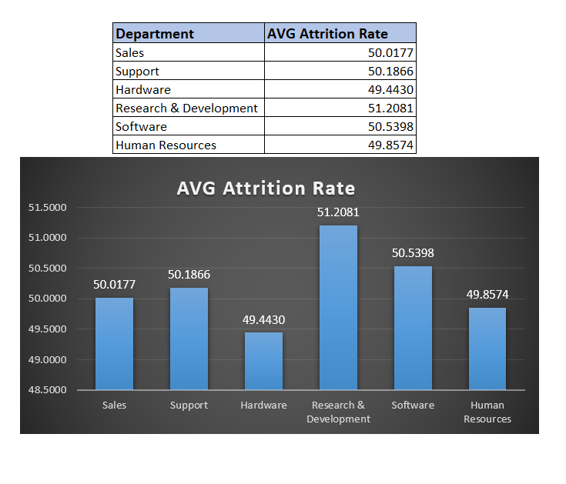
1. Average Attrition rate for all Departments
The insights driven using excel is shown here:
Data shows that Research & Development department has highest attrition rate while hardware has lowest.
We can see salary hike is not the reason of attrition cause R&D department getting good percentage salary hike.
In this department attrition of Females are more.
In HR, software department attrition of male is higher than female, while in other department female attrition rate is higher than male.
Work life balance is good for this department.
Attrition is more who has more working years in current role.
One reason can be the manager they are working under.

Slide 8
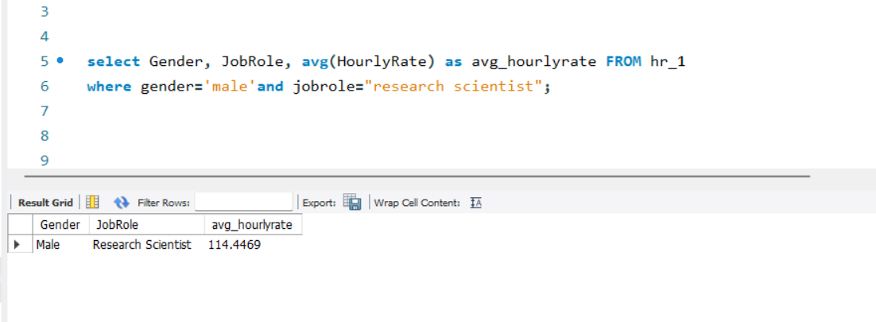
2. Average Hourly rate of Male Research Scientist
The insights driven using my SQL is shown here:
Min hourly rate = 30
Max hourly rate = 200
AVG hourly rate of male research scientist is coming as 114.45
While for female its 115.9
Work life balance for research scientist is average.

Slide 9
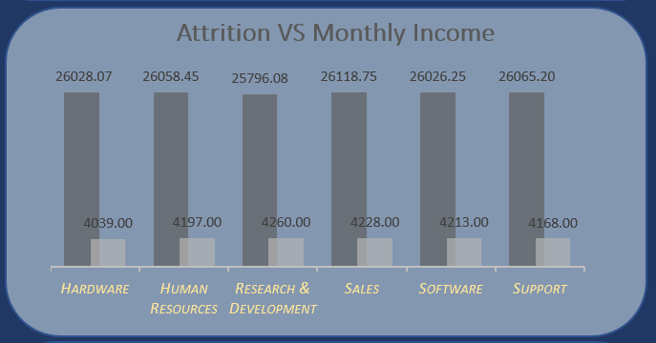
3. Average Rate Vs Monthly Income Stats
The insights driven using Excel is shown here:
Min salary =1001
Max salary = 50999
Maximum salary hike is for 20-30k salary bin.
Max attrition is from 40-50k salary bin.
That may be because they are getting better salary option in other company for the same work.

Slide 10
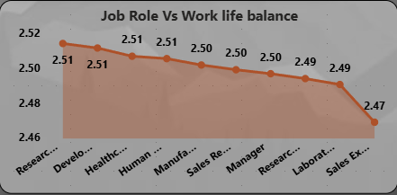
4. Average working years for each Department
The insights driven using Power BI is shown here:
Avg. working year for Sales department is highest and for R&D department its lowest.
But sales department. has the lowest salary hike.
We have to work on R&D department.

Slide 11
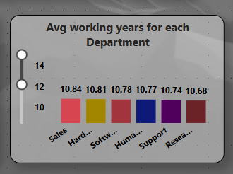
5. Job Role Vs Work life balance
The insights driven using Tableau is shown here:
We can see that Laboratory technician and research director are having excellent work life balance.
While HR is having poor work life balance.
Employees from HR department are not getting promotion frequently and they are getting less monthly income.

Slide 12
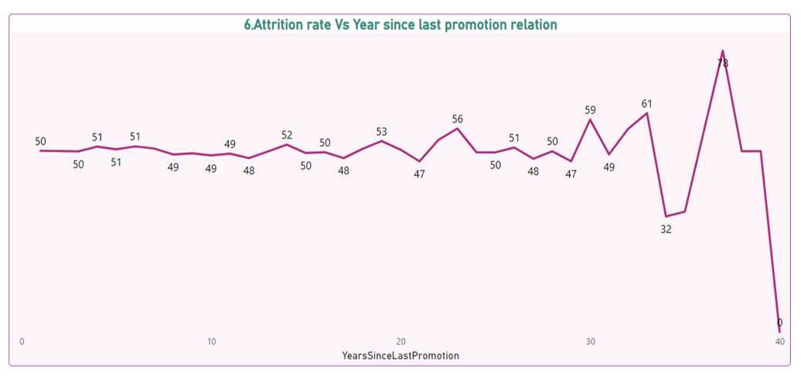
6. Attrition rate Vs Year since last promotion relation
The insights driven using Power bi is shown here:
The graph shows slight fluctuation for attrition of around 50% for the employee who have recently got promotion.
While the employees who have not got promoted for more than 20 years they shows more fluctuation in attrition graph.

Slide 13

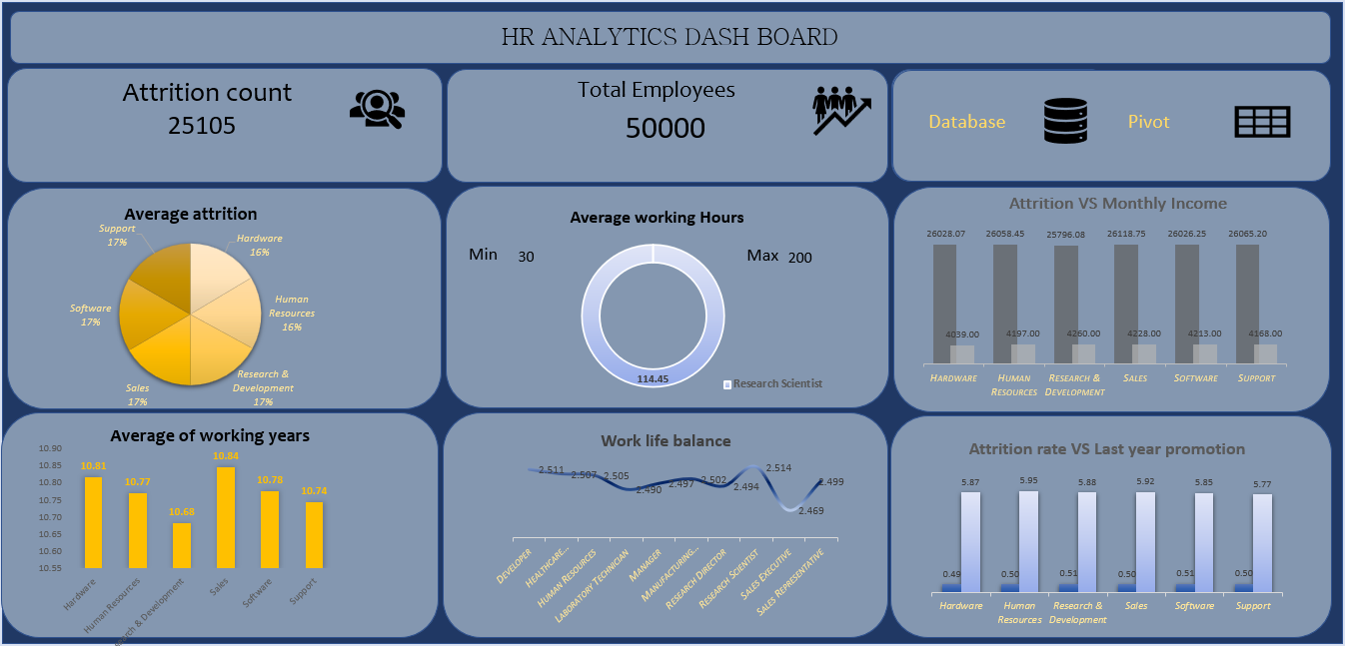
EXCEL DASHBOARD

Slide 14
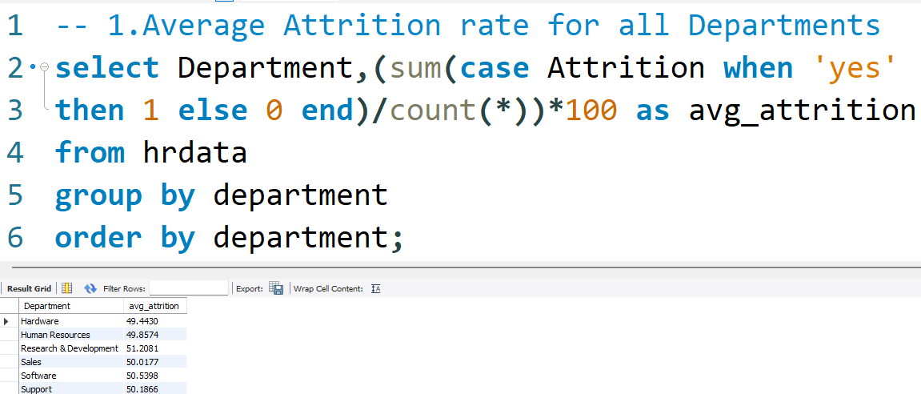
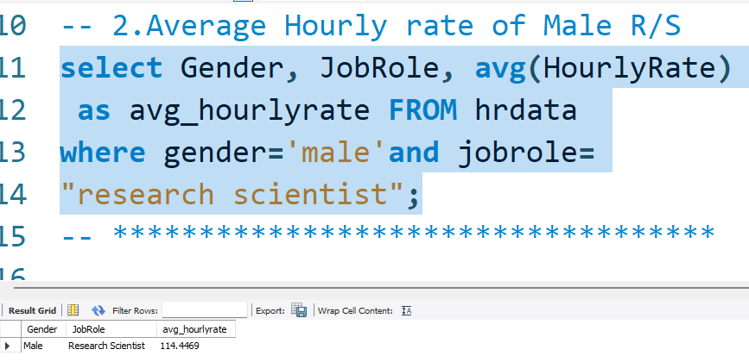
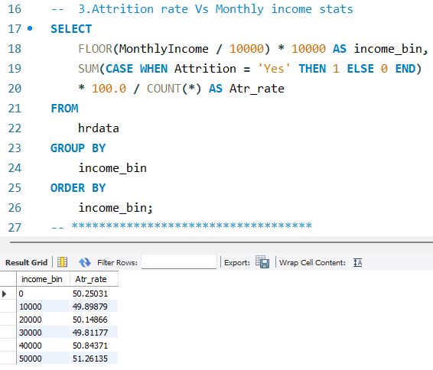
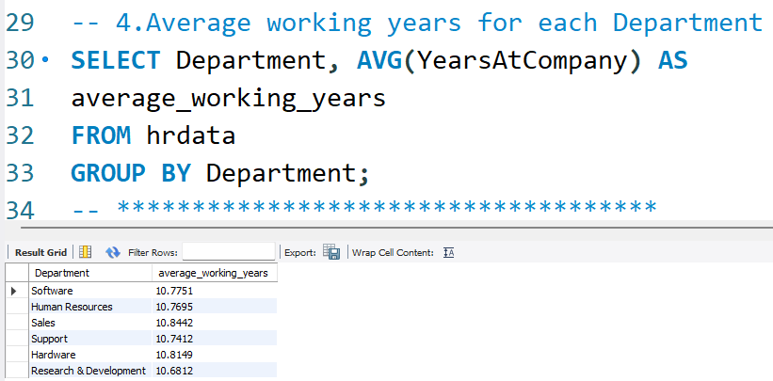
MYSQL ANALYSIS

Slide 15
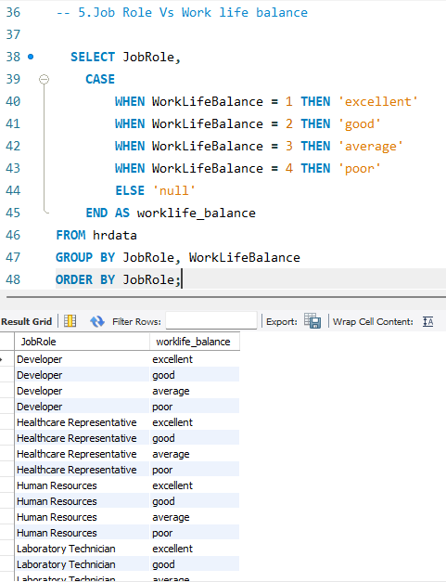
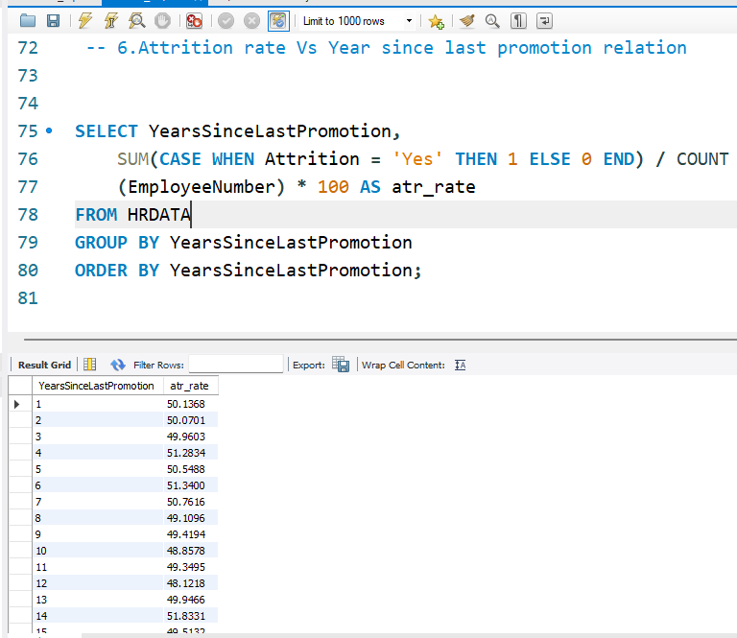
MYSQL ANALYSIS

Slide 16
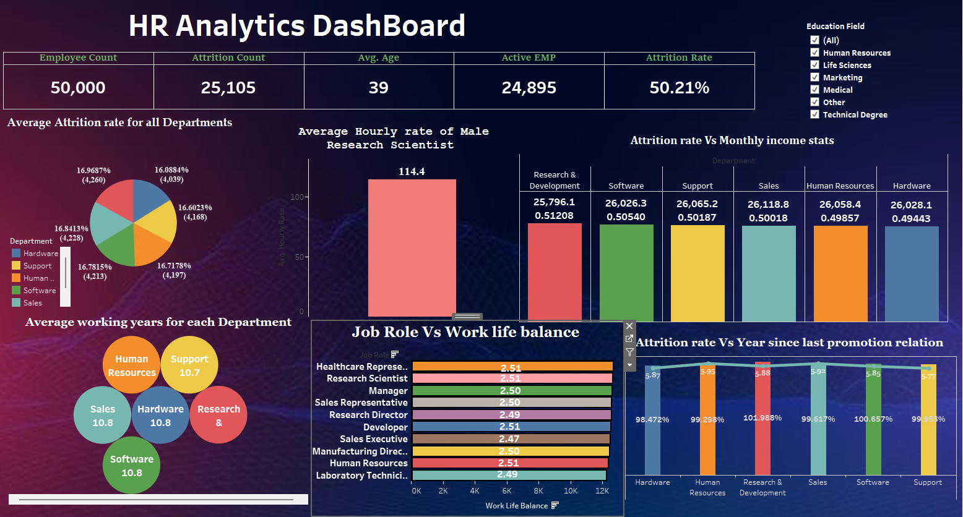
TABLEAU DASHBOARD

Slide 17
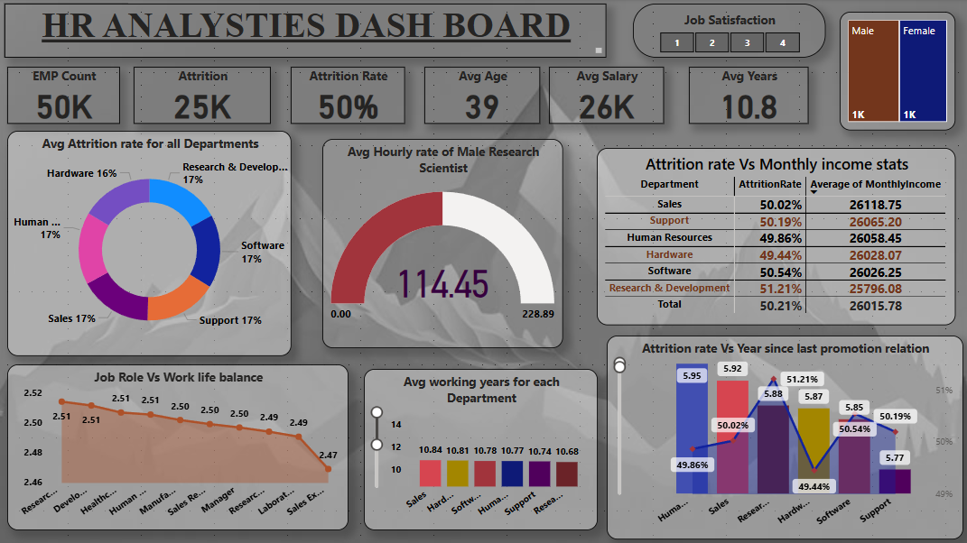
POWERBI DASHBOARD

Slide 18
COUNCLUSION
The HR analysis provides a comprehensive view of workforce dynamics, revealing key patterns that demand focused attention. A notably high attrition rate of 50%, especially in critical departments like Research & Development and Sales, underscores the urgent need for targeted retention strategies.
Although the organization boasts an impressive average tenure of 10.8 years, the disconnect between employee longevity and attrition trends suggests underlying issues related to career growth and job satisfaction.
Furthermore, the analysis of job satisfaction scores and work-life balance metrics highlights significant opportunities for improvement.
Employees in departments with lower satisfaction scores or balance metrics, such as Sales and Support, may benefit from tailored interventions to address these challenges.

Slide 19
THANK YOU
PRESENTED BY GROUP 5

